Slide 1
Using Destiny Quest
Online Library Catalog

Slide 2
Type Keyword in the Search Bar
Notes:
The first book is labeled “ASK.” This means we do not have a copy in our library, but there is a possibility that we could borrow it from another school in our district.
The second book is “IN,” which means the book is available for checkout. If it had said “OUT,” that means another student has checked it out. Fortunately for you, we have pulled the books for your research. After you search for a title, you’ll be able to find it in your teacher’s classroom. We did this so no other students can check out the books you might be needing for your research!
The third book is an eBook. You can click on “Follett Shelf” at the top of the Destiny Quest screen. If you are logged in to Destiny Quest (using the same login credentials as you use for Accelerated Reader), you’ll be able to access and open the book. Sometimes the book is not available in Follett Shelf, so you may also want to try using “SORA,” another application that you can link to from the library webpage.

Slide 3
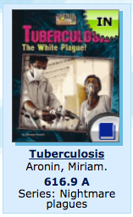
You can see the book’s call number is 616.9 A.
616.9 is a Dewey decimal number that helps us find the book’s location in the library.
The A is for the first letter of the author’s last name.

Slide 4
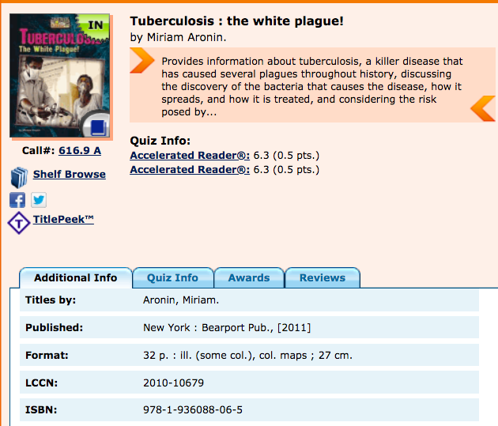
*Brief synopsis of the book
*AR quiz information.
ISBN Number you’ll need when you create a citation for this source!

Slide 5
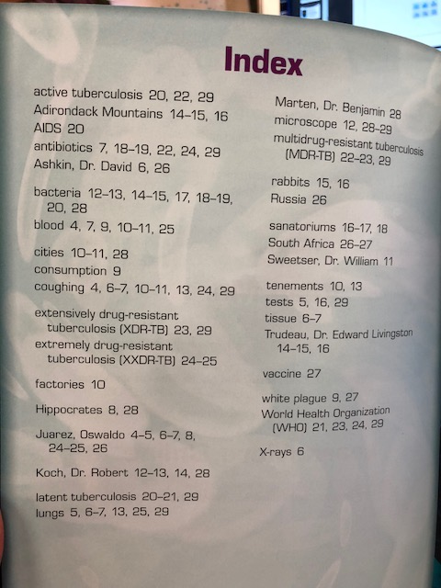
Imagine… that this was a great and useful source, but you still didn’t want to read the entire book!!
Notes:
Use the Table of Contents and the Index to find probable locations of the information you need, then take some notes!

Slide 6
Cite Your Source!
Notes:
Use Zotero Bib to create your book citation.

Slide 7
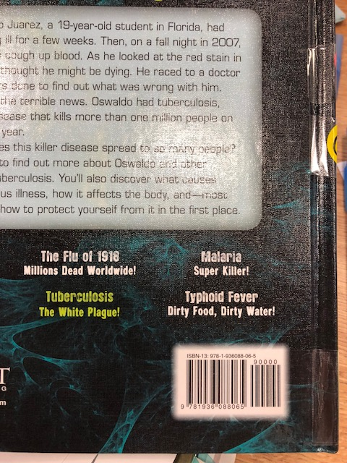
Cite Your Source!
YES!!!
NO!!!
Notes:
Find the book’s ISBN barcode number (10 or 13-digit number – NOT the school’s library barcode.

Slide 8
Cite Your Source!
Notes:
Use Zotero Bib to create your book citation.

Slide 9
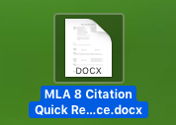
Use the MLA 8 Citation Quick Reference

