Slide 1
RADCAB
Appropriateness

Slide 2
Is this website APPROPRIATE for me?
Does it fit with my core values?
Will it help me answer my research question?
Can I read and understand the information?

Slide 3


Slide 4

KEEP IN MIND . . .

Slide 5
CORE VALUES
Good for Me
Not Good for Me
Personal boundaries
Keep private
  phone numbers
  house addresses
  inappropriate pictures/videos/messages
Keep my future reputation safe
If meeting an online friend, take a parent or guardian; meet in a public place
Save evidence and report online incidents to parent/guardian/other adult
Report website, CyberTipline.com, or police
Website or app feels unsafe or dangerous
Website is labeled “adults-only”
Inappropriate pictures/videos/messages
Posting rude or harmful information about other people
Meeting online friends in person by yourself
Keeping others’ inappropriate online behavior to yourself

Slide 6
Internet Safety Pledge
for Middle and High School
I will talk with my parents or guardian about their expectations and ground rules for going online. The rules will include the time of day I may be online, the length of time I may be online, whom I may communicate with online, and appropriate areas for me to visit online.
Adapted from NetSmartz.org

Slide 7
Internet Safety Pledge
for Middle and High School
I will keep my identity private. I will never share my full name, mailing address, phone number, name of my school, photo or other information that someone could use to determine my identity.
Adapted from NetSmartz.org

Slide 8
Internet Safety Pledge for Middle and High School
I will never respond to any online communication that makes me feel uncomfortable. I will tell a trusted adult if I come across any information that makes me feel scared, uncomfortable or confused. I will never respond to messages that are rude or offensive. I will show the message to a trusted adult right away.
Adapted from NetSmartz.org

Slide 9
Internet Safety Pledge for Middle and High School
I will never meet in person with anyone I have first "met" online without discussing it with my parents or guardian. I won't meet in person with anyone unless my parents or guardian agree to the meeting and will go with me, and the meeting will be in a public place.
Adapted from NetSmartz.org

Slide 10
Internet Safety Pledge for Middle and High School
I will respect other people's rights while online. The Internet is a community and my online behavior affects others. I will always treat others in the way I would like to be treated. I will respect copyright laws and check on sources. When writing reports I will make sure that the online sources of information are credible and I will cite my sources.
Adapted from NetSmartz.org

Slide 11
PLAN AN “EXIT STRATEGY”
What kinds of internet content are not okay for me?
What will you do if you see inappropriate content on a website?

Slide 12
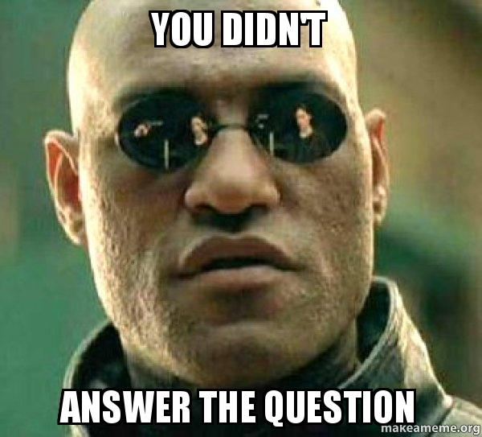
Find an Answer to Your Research Question!
(Also…. What IS Your Research Question?)
How does the disease affect an individual person?
How does the disease impact a society?
What is the outlook for this disease today?

Slide 13

It’s Only Useful If
You Can Actually Read and Understand It!

Slide 14
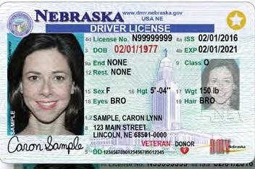
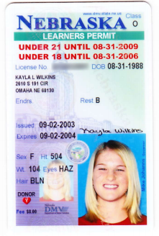
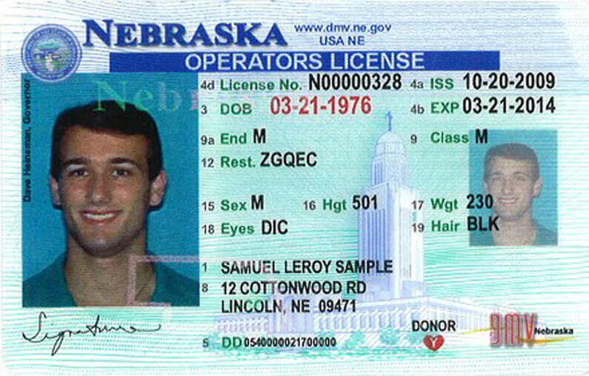
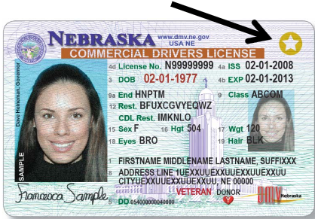
Operator’s License
Learner’s Permit
Motorcyle License
Commercial License (CDL)
Notes:
Different reading levels are like different kinds of driver’s licenses. If you have an operator’s permit, a regular vehicle like a car is what you’ve been trained to drive, what you have experience with, and what you’re good at! If you have another license, like a CDL license, you’re ready for heavy loads, maybe hazardous materials, or more than 16 passengers at a time.
It’s important to find your correct reading level so you are reading information you are likely to have success with. Reading at this level will help you gain experience and increase your skills!

Slide 15

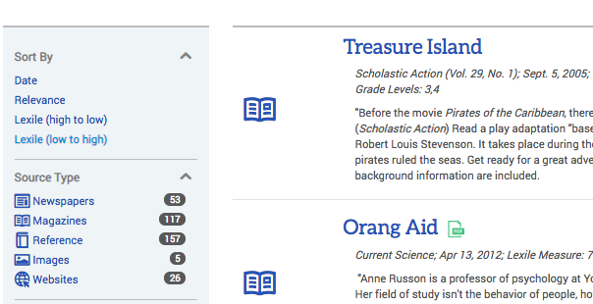
Know Your Lexile

Slide 16

Consider the Book Level
By the way, this is a great Golden Sower-nominated book by Lynn Plourde.
If you’ve ever loved a dog… you will love Maxi’s secrets.

Slide 17
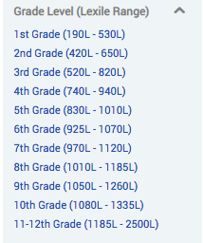
Know Your Lexile
USER NAME: ne47746
PASSWORD: 68850

Slide 18




WorldBook Online
User Name: lexington11
Password: worldbook1

Slide 19
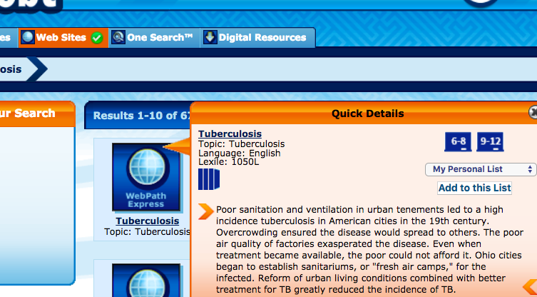
Destiny Quest Web Sites
Notes:
Click on link and it will take you to the website. You can also check the lexile.

Slide 20

QUIZ: Which source is “JUST RIGHT”?
https://www.worldbookonline.com/student-new/#/article/home/ar437100/polio
https://69710603.weebly.com/jonas-salk-life-and-the-cure.html
https://www.eurosurveillance.org/content/10.2807/1560-7917.ES2014.19.7.20709
Can you understand what is written on this website?
Who do you think this website is intended for?
Is this website appropriate for you?
Which of the three is the most appropriate source for you?

